Slide 1
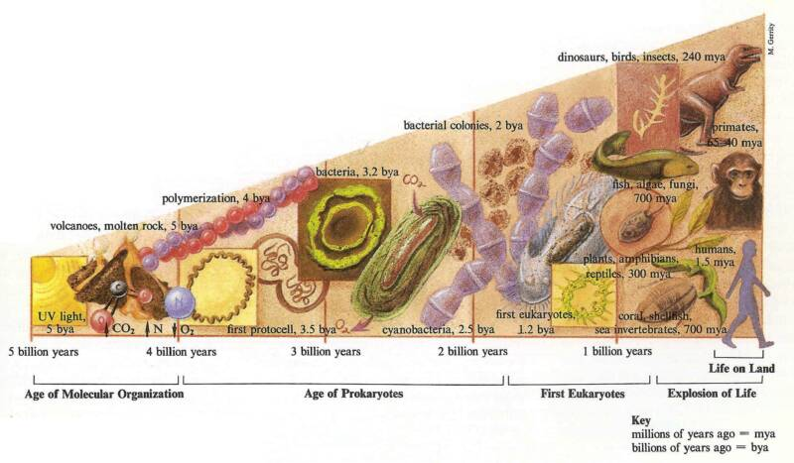
Evolution
By the end of this lesson I will be able to:
Describe what evolution is
Explain the process of natural selection.
Explain some of the reasons why extinctions happen.

Slide 2
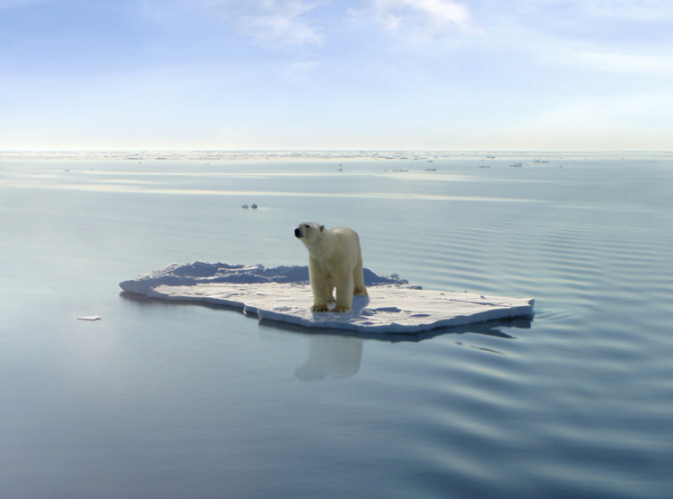
Why are polar bears in danger of extinction?

Slide 3
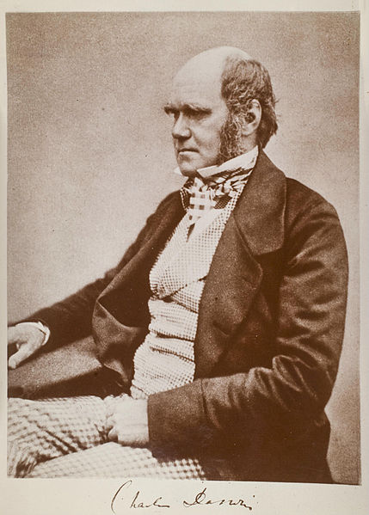
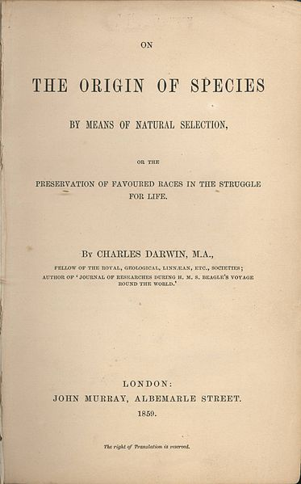
How did the giraffe get its neck?
Published 24th November 1859
Individuals stretch to reach leaves high in trees…
Original short – necked ancestor
Individuals stretch to reach leaves high in trees…
…and continue to stretch so that neck gets longer an longer.
Individuals with long necks pass on this trait to their offspring until the whole population has long necks.
…and continue to stretch so that neck gets longer an longer.

Slide 4
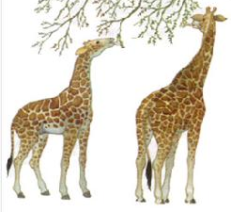
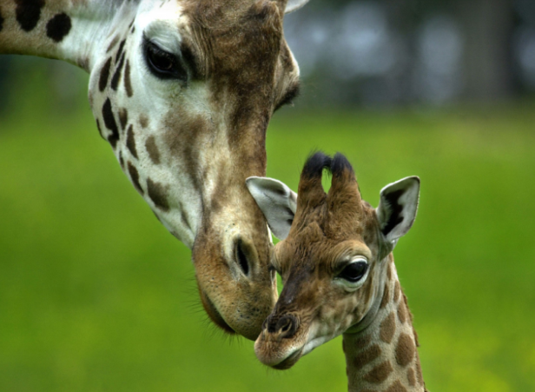
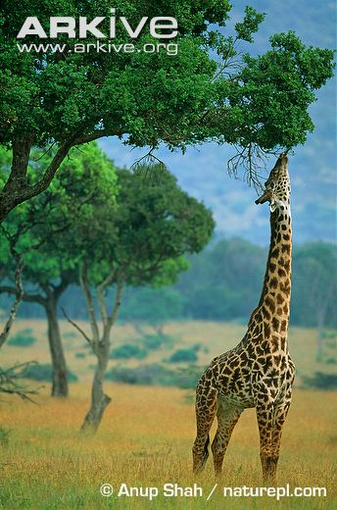
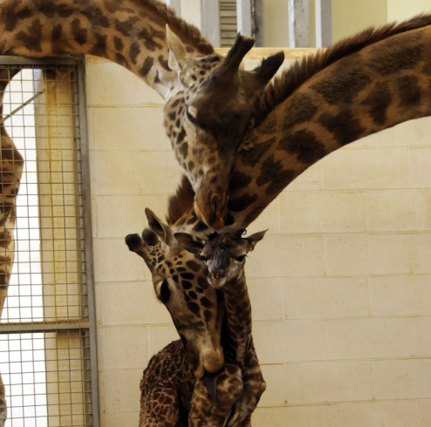
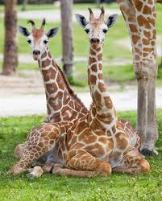
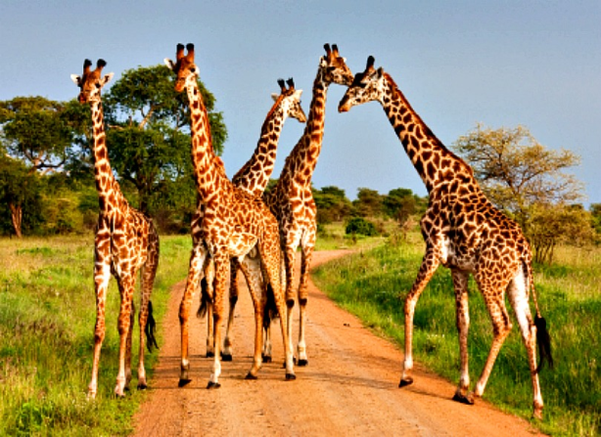
Giraffes had necks of varying lengths which are shorter overall than those of modern giraffes.
The giraffes with the longest necks could reach more leaves than those with shorter necks.
The giraffes with longer necks were more likely to survive to reproduce than those with shorter necks.
The offspring of giraffes with longer necks inherit the genes for a long neck from their parents.
Over thousands of generations the numbers of offspring with longer necks increases.
Giraffes still have necks of varying lengths but they are longer overall than those of their ancestors.
This process is called Natural Selection

Slide 5
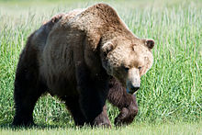
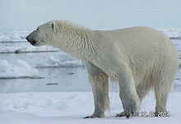
Evolution of polar bears….
Polar bears are thought to have evolved from a population of brown bears that were cut off by a glacier in the northern part of their range about 130 thousand years ago.
The oldest fossil that is completely like a modern polar bear is about 20 thousand years old (the teeth were still like those of a brown bear until this point).
Brown Bear | Polar bear
Large, muscular with big skull. Black skin and Brown fur Omnivores (eat whatever they find) Front paws are smaller than back paws. Stores fat before hibernation. Aggressively territorial | Larger than brown bear but longer, sleeker shape. Black skin and transparent fur. Carnivores/ hunters with specialised teeth. Large feet for swimming and weight distribution in the snow. Has a thick layer of blubber under the skin. Solitary but not territorial, avoid confrontation.
Use this information to complete your own story board for the evolution of polar bears

Slide 6
So….Why are polar bears in danger of extinction?
Use what you have learnt to answer the question in as much detail as possible.

