Slide 1
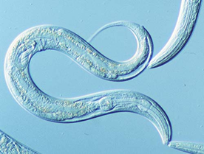
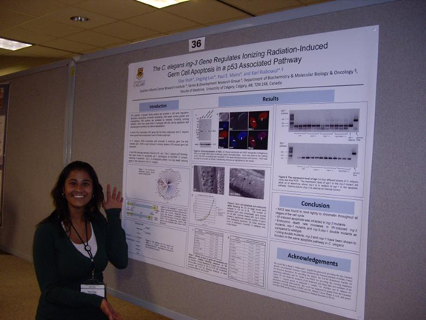
Your investigation
By the end of this lesson I will have;
decided on the question my investigation will answer.
come up with a hypothesis
identified my variables.
written my method and stated how I will make this a fair test.

Slide 2
Your investigation
What is your question and how will you go about answering it?
What is your hypothesis? What will happen?
What are your variables?
Independent – What will you change?
Dependant – What will you measure?
Control – What will you keep the same?
What equipment will you need?

Slide 3
Your investigation
Write your method out in full.
Clear step by step instructions that could be followed by another researcher.
Include details to show how you will control your variables to make it a fair test (i.e. always use 5ml ethanol)
How will you make your results reliable?
How will you record your results? Design a table.

Slide 4
Your results
What kind of graph can you use to show your results?
Describe your results. What can you see?
What do your results show?
Are your results what you expected? Do they prove or disprove your hypothesis?
Evaluate your results…
Are they reliable? How precise are they?
How could you improve your method to get better results?

