Slide 1
Accessing the Psychology Booking System
If you are off-campus, you will need to access the Southampton Virtual Environment sve.soton.ac.uk prior to accessing the booking system!
The SVE is useful for lots of other functions, as you can access all the software etc. that’s available on University computers, as well as your My Docs and other folders.
Just sign-in with your normal Uni credentials, then access this link.
Psychology Equipment Booking
You will then be taken to the Psychology Technical Sharepoint site. You may need to sign-in again to Sharepoint.
Please note that the Sharepoint site will be changing at some point this semester. We will keep you informed of any changes you may need to make to the links once this has been carried out.

Slide 2
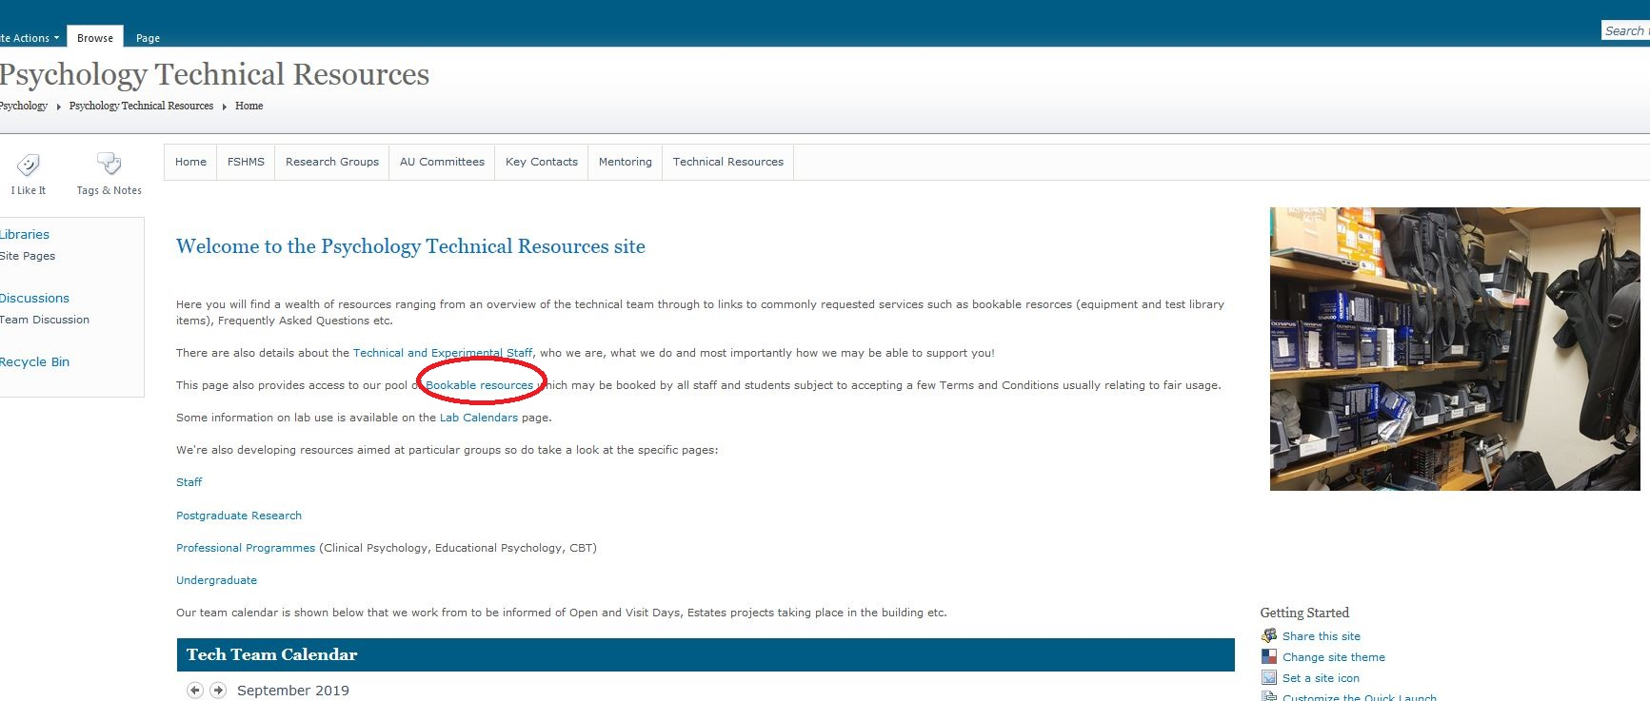
Click on the link to “Bookable Resources”

Slide 3
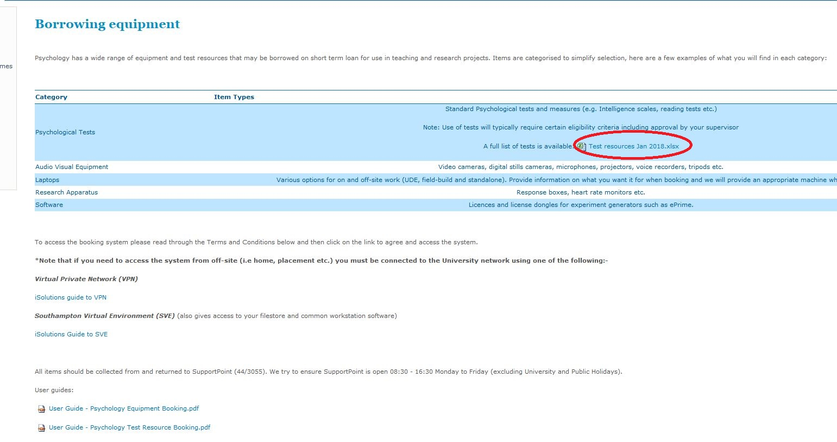
You’ll find a list of Test Library resources here, as well as useful guides and advice.

Slide 4
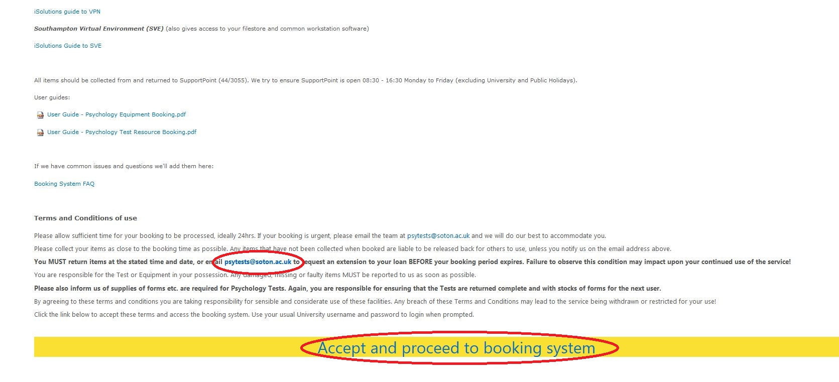
Scroll to the bottom of the page, read the T & C’s and click to accept. You’ll also see the dedicated Test Library email address here. Please use this to request extensions to loans or for other Test Library enquiries.

Slide 5
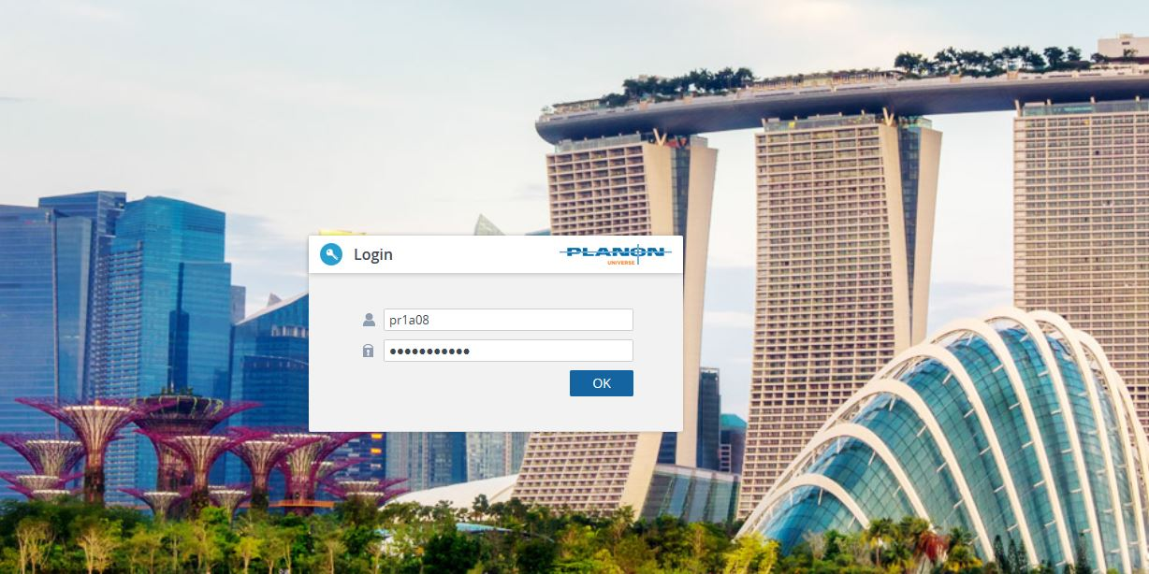
Log-in to the Booking System with your usual ID etc.

Slide 6
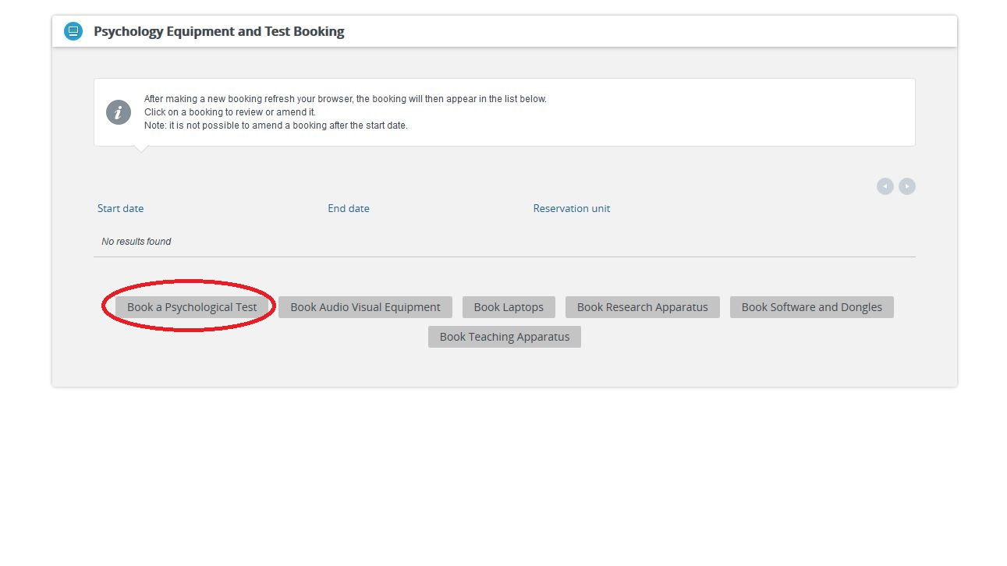
Click the link! You’ll also see any other bookings you have made on this page. This is also where you’ll need to go to book voice recorders, cameras etc. via the other links

Slide 7
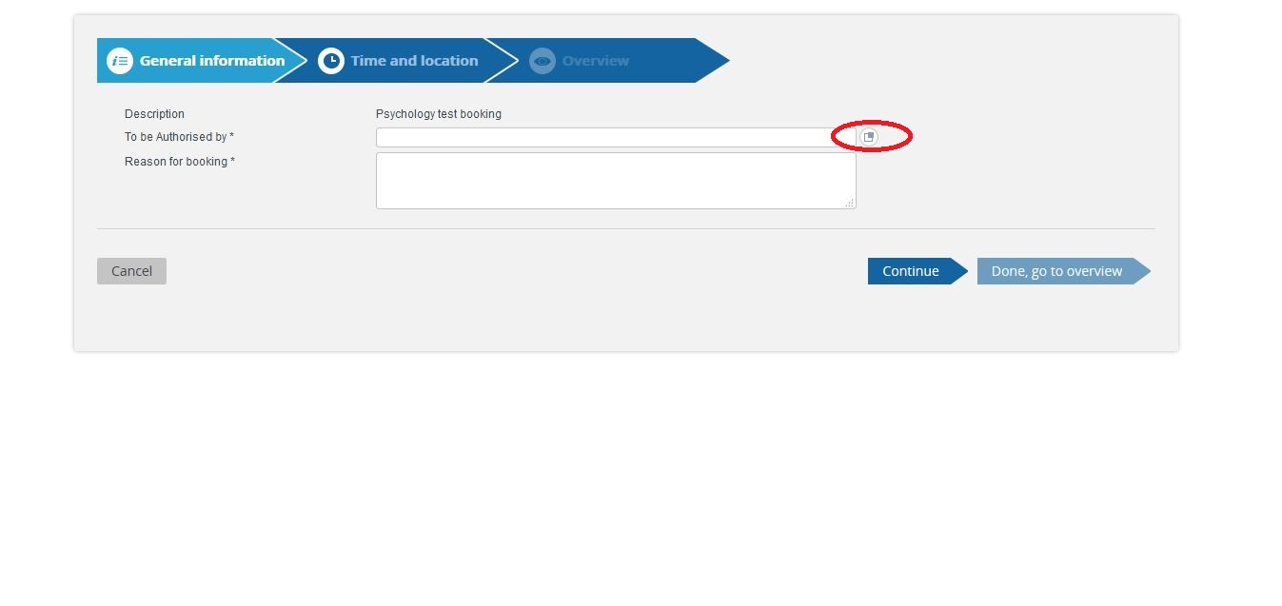
Click the box and then select your supervisor from the drop-down menu, and enter your reason for the loan.

Slide 8
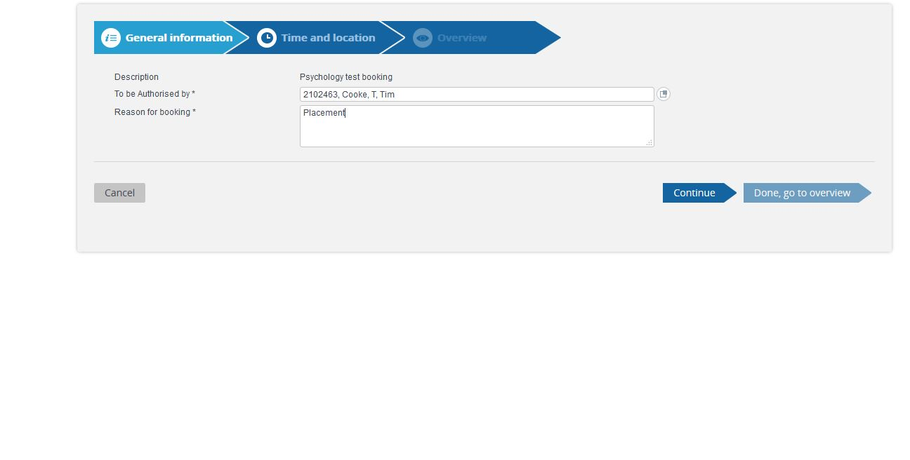
Now is the time to remember that you can’t borrow a test without your Supervisor’s authorisation! Please don’t leave it to the last minute to make your bookings as they may not be authorised. Usually we would like 24hrs notice, but will try and be flexible where we can.

Slide 9
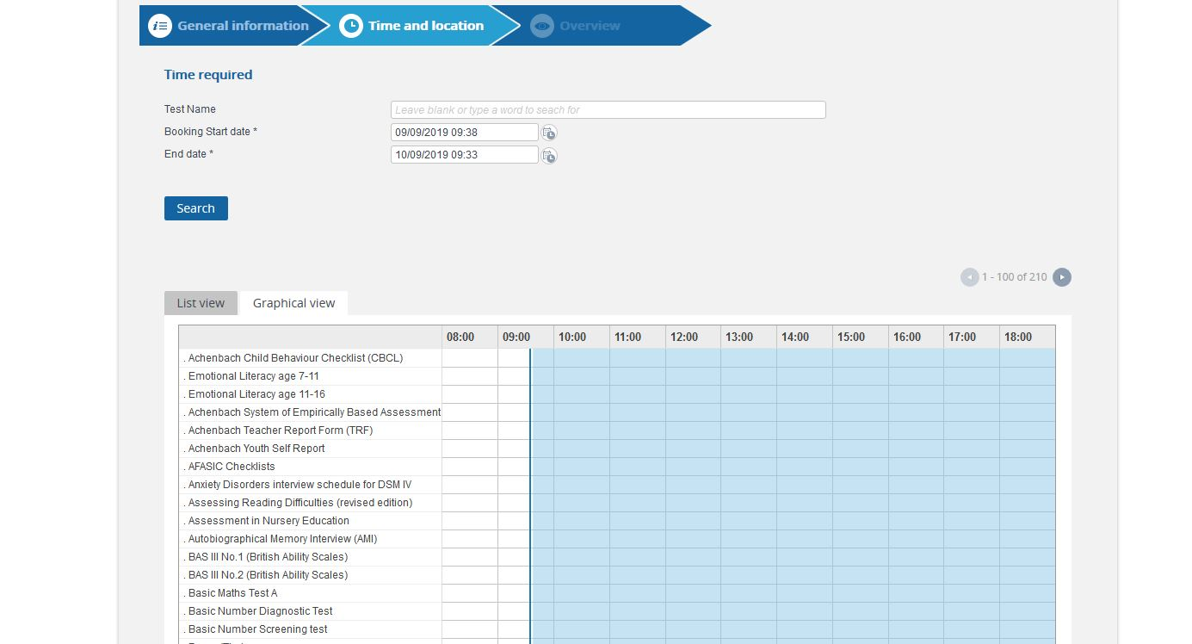
Enter the dates you require the test, then click on the test you wish to borrow from the list. The page will then reload, but your selection will be saved. The “next page” button is at the bottom of this screen. You can also search by name for the test you require.
The system will only show items that are available for the dates you request. If a test is already booked out it will not show up in the list!!!

Slide 10
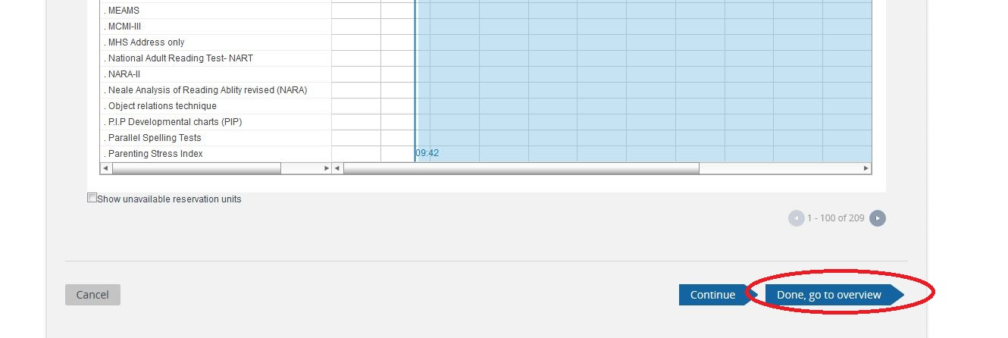
Scroll to the bottom of the page once you’ve clicked on your selection and click the “Done” button.

Slide 11
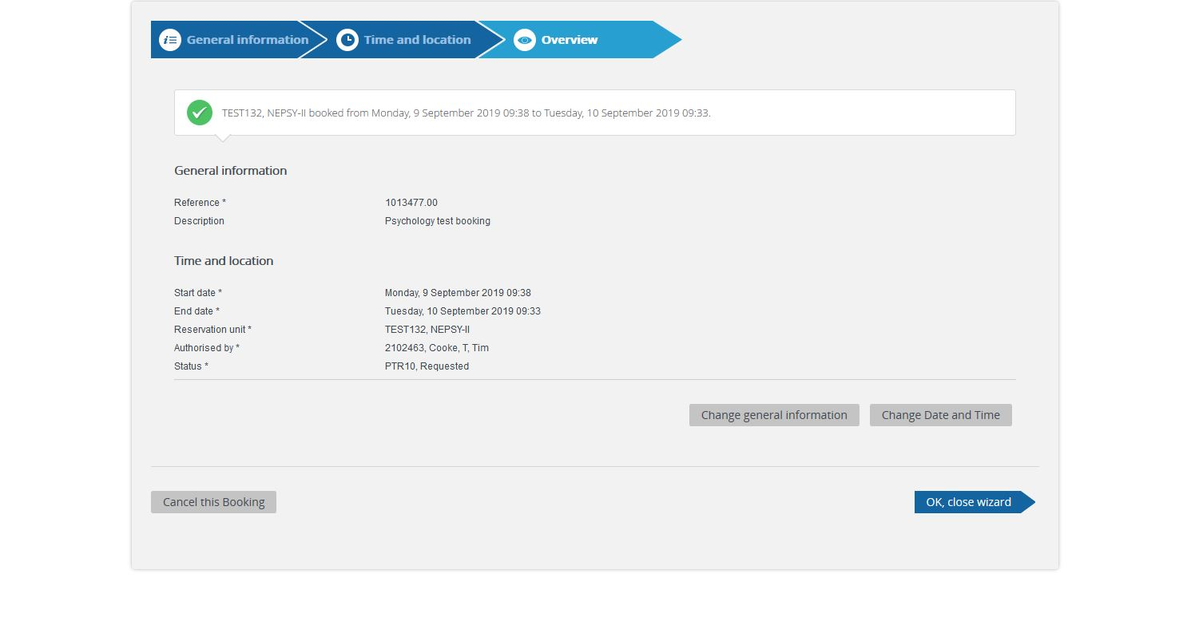
You’ll now see your booking and it’s status (Requested). This will change to Authorised once your Supervisor has confirmed your booking.

Slide 12
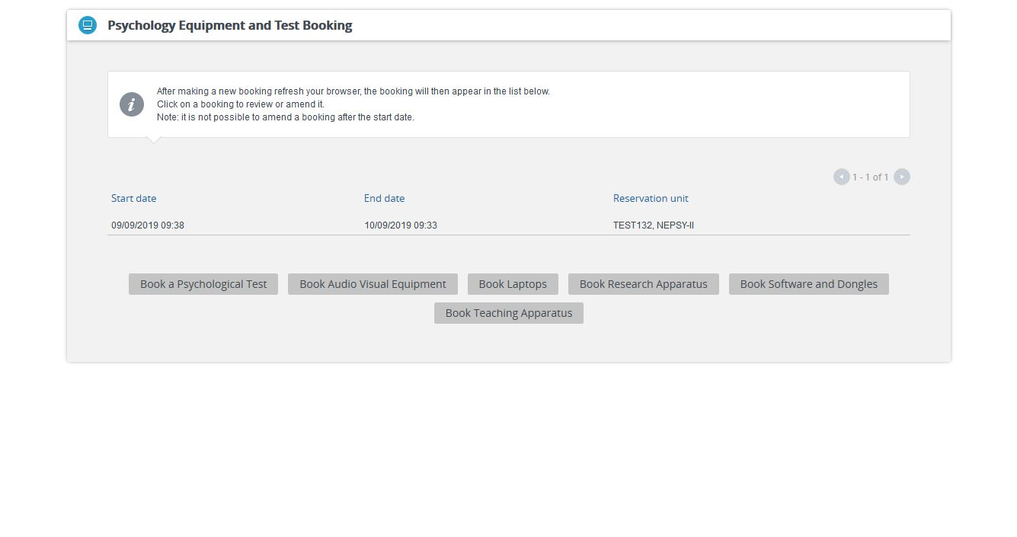
You’ll now see your booking in the list on your Home page. It’s not possible to change bookings yourself once you’ve entered them. Please email psytests@soton.ac.uk for any changes, or pop in and see me in room 3055.

Slide 13
Important information!
The Support Point (where you pick your tests up from (44/3055)) is open 0830-1700 Monday-Thursday and 0830-1330 on Fridays. Please try and arrange your bookings around these times.
Please ensure that the test you collect has everything you need in/with it before you take it away! It’s no fun going on Placement miles away to discover you don’t have everything you need…
Please inform me or one of the other Techs if items are missing.
Please let us know if stocks of forms/response booklets and other consumables are getting low, your colleagues will be impacted by any shortfall in this area, and it is pretty much impossible for us to keep track of. We rely on you to keep us informed, and can order any items required. There is, however, usually a significant lead-time on orders, so letting us know as soon as you notice is vital!
The Test Library can only function properly if we work together!
Thanks!

