Slide 1
Welcome to Psychology

Slide 2
Key Contacts in Psychology
Head of Department
Matt Garner Professor of Psychology & Affective Neuroscience
Joint Honours Programmes Co-ordinator
Jana Kreppner (j.kreppner@soton.ac.uk) Associate Professor
Director of Programmes, Psychology
Edward Redhead (E.Redhead@soton.ac.uk) Associate Professor

Slide 3
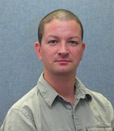
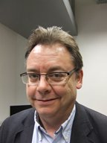
Your programme directors:
Programme Director BSc Criminology & Psychology
Craig Webber (C.Webber@soton.ac.uk)
Programme Director BSc Education & Psychology
David Galbraith (D.W.Galbraith@soton.ac.uk)
Programme Director LLB Law with Psychology
Mel Kazarian (M.Kazarian@soton.ac.uk)

Slide 4
Degree Programme | BSc Criminology and Psychology BSc Education and Psychology LLB Law with Psychology |  |  | BSc Psychology
Faculty | Faculty of Social Sciences |  |  | Faculty of Environmental & Life Sciences
Schools within Faculty | Social Sciences, Southampton Business School, Southampton Education School, Southampton Law School, Statistics and Operational Research. |  |  | Biological Sciences, Geography and Environment, Health Sciences, Ocean and Earth Science, Institute of Life Sciences, Psychology.
Dean: | Prof Jane Falkingham |  |  | Prof Rachel Mills
Associate Deans: Education | Prof Jim Anderson |  |  | Prof Sarah Stevenage
Research & Enterprise | Prof Sally Brailsford/Prof Rebecca Hoyle |  |  | Prof Jon Bull
International | Prof Sabu Padmadas |  |  | Prof Sue Colley
School | Economic, Social and Political Sciences Department of Sociology, Social Policy & Criminology | Southampton Education School | Southampton Law School | School of Psychology
Head of School | Prof Niko Tzavidis (HoS) Prof Jenny Fleming (HoD) | Prof Martin Dyke | Prof Brenda Hannigan | Prof Matt Garner
Head/Director of Teaching Programmes | Paul Bridgen | Adrian Halnan | Mark Telford | Ed Redhead
Your UG Programme Leads | Craig Webber | David Galbraith | Mark Telford | Claire Hart
Joint Honours Liaison | Jana Kreppner (Psychology)
Senior Tutor | Graham Baxendale | Adrian Halnan | Jan Steele | Daniel Schoth

Slide 5
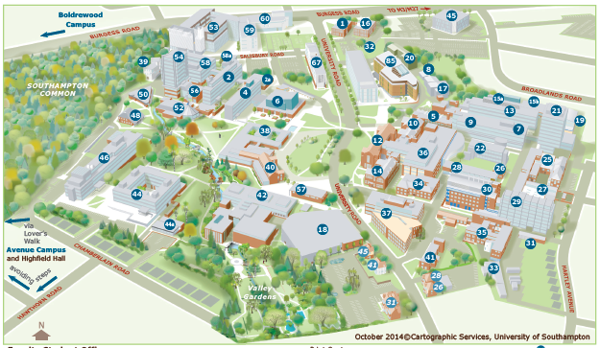
Where is Psychology?
Shackleton Building (Building 44), levels 3 & 4

Slide 6
PSYCHOLOGY AT SOUTHAMPTON
A long history of excellence in education and research
Join a large, vibrant, leading UK Department.
+50 academic staff at the forefront of their fields.
A UK leading provider of postgraduate research and professional training.
A unique opportunity to study alongside scientists, clinicians, educational psychologists, health practitioners and postgraduate trainees
4 Research Centres:
Innovation in Mental Health
Vision & Cognition
Clinical & Community Applications of Health Psychology
Self & Identity
Notes:
I’ve had the pleasure to work at Southampton for 15 years, and have thoroughly enjoyed working with talented students like yourselves.

Slide 7
Your degree: Joint Honours
50/50 your discipline and Psychology
Core, compulsory and optional modules
BPS accredited

Slide 8
British Psychology Society (BPS) Accreditation
Your degree meets the requirements of the British Psychological Society (BPS)
Graduates are eligible to apply for the Graduate Basis for Chartered Membership (GBC)
Pass your Research Project at a minimum mark of 40%.
Achieve a minimum of a lower 2nd class honours (2:2) degree grade at the end of your three years.
a prerequisite for further professional training accredited by the BPS.
Notes:
Your programme achieves this goal by assuring both the quality and content of the individual units.

Slide 9
Your degree: Law with Psychology
75% Law and 25% Psychology
Core, compulsory and optional modules
Accredited by the Law Society of England and Wales & the Bar Council of England and Wales

Slide 10
Where to find all the information?
Your Programme Handbooks are online:
https://www.southampton.ac.uk/studentservices/academic-life/faculty-handbooks.page

Slide 11
Your discipline and Psychology
Referencing (Harvard versus APA)
Submission: differences in the different disciplines (e-assignment and Turn-it-in, deadlines)
Research Participation linked to PSYC modules
(more in depth explanation in e-systems workshop)

Slide 12
Further Opportunities in Psychology
VRA scheme
Summer Placements
Career Development Opportunities:
Employability and Personal Development Blackboard Site (describing different career paths, incl. qualifications and job descriptions)
Inform you of opportunities via e-mails and plasma screen
Student Employability Officer Dr Tom Randell, (T.D.W.Randell@soton.ac.uk).

Slide 13
How to make your voices heard
SSLC in Psychology
Your course rep (representing years 1, 2 and 3) will be invited
Psychology Undergraduate Board
Your course rep will liaise with Psychology’s Academic President (BSc course rep)
Jana Kreppner (joint honours) is your academic contact in Psychology.

Slide 14
Further Psychology Induction Sessions (for joint honours students):
“Effective Learning Workshop”
Interactive Workshop to discuss and prepare for your study at University
BSc Education and Psychology:
Thursday, 27th September: 14:00-16:00, in 44/3029
BSc Criminology and Psychology:
Friday, 28th September: 14:00-16.00, in 44/3029

Slide 15
Further Inductions:
E-systems Workshop for Psychology:
The session will appear via your online timetables.
Library Induction:
Timetabled – within your department;
Academic Integrity:
Organised within your department

Slide 16
Double the work? or Double the Possibilities?

