Slide 1
Welcome to
Year One!
School of Psychology

Slide 2
Year 1 Induction Overview
Welcome from Head of School – Professor Matt Garner
Health & Safety – Mr Pete Dargie
Year 1 Tutor – Dr Anne McBride
Road Map through 3 years – Dr Claire Hart
Academic Support – Dr Ed Redhead
Student Pastoral Support - Dr Daniel Schoth
Student Representation – Ms. Eliscia McKeough

Slide 3
Congratulations! & Welcome to your School of Psychology

Slide 4
Your School of Psychology
You’ve joined one of the largest and most popular Schools in the University.
+500 UG students
+70 academics, clinicians, educational psychologists, health practitioners.
+100 post-graduate students and trainees
A stimulating, supportive and passionate community of students and staff.

Slide 5
Your School of Psychology
Be proud of everything that you’ve achieved.
Look forward to everything that you will achieve.
Be proud of your chosen subject – it really is the best.
Be proud of your School, your fellow students, your staff and our University.
Be proud of our shared ambition to study, research and apply Psychology to make a difference in the world.

Slide 6
Health & Safety reminder…
Know what to do in an emergency:
Fire
Injury requiring first-aid and/or emergency services
Know how to contact security:
Emergencies 3311 (int.) or 02380 593311 (ext.)
Report accidents, incidents, or concerns to your Personal Academic Tutor, or other appropriate member of staff (e.g. Student Office)
Keep access routes clear and avoid creating tripping hazards. Do not tamper with electrical equipment.
Smoking is not permitted in or around University buildings.

Slide 7
Learning Opportunities In Year One

Slide 8
Year Tutor
Each academic year has an allocated year tutor.
The year one tutor is me
Anne McBride ☺
My role is to
provide additional support to you and your PAT in regard to all things academic.
A complementary role to that of the Psychology Student Support team.

Slide 9
Year 1 Curriculum
Semester 1
PSYC 1016 Intro to Psych Compulsory
PSYC 1010 Research Methods and Data Analysis 1 - Core
PSYC 1005 Language and Memory - Core
Option e.g. PSYC 1015 (Classic Studies)
Semester 2
PSYC 1017 Behavioural Neuroscience - Core
PSYC 1018 Individual Differences - Core
PSYC 1019 Research Methods and Data Analysis 2 - Core
Option e.g. PSYC 1014 (Psychology of Attractiveness)

Slide 10
Psyc 1005 Thinking Psychologically
Enables you to begin to develop academic and key skills
that will serve you ALL through your life
In your university studies
In work
In relationships
In understanding the world around you

Slide 11
This is done through
Weekly 2 hour (compulsory) meetings with
Your Personal Academic Tutor
and
9-10 other first year students
Working together in a supportive, co-operative manner

Slide 12
and
Some additional supplementary all year group meetings on
Introduction to the module
Academic Integrity
Essay planning and feedback
Critical Thinking
Please note that attendance at all PSYC 1005 sessions is compulsory.

Slide 13
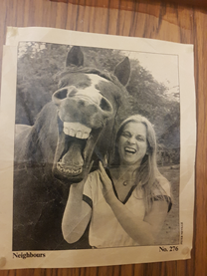
First of these lectures is next Wednesday
Introduction to the Module Content and Structure
10.00 – 12.00 on Wednesday 3rd October (46/3001)
(see your timetable ☺)
With ME ☺ ☺

Slide 14
PSYC 1005 : end of term conference
Exciting!!!
Each group showcases their work to colleagues in the form of an academic conference

Slide 15
Studying Psychology: Your Journey

Slide 16
The Undergraduate Programme
Year 3 Options
Cognitive PSYC3048 Human Learning PSYC3043 Understanding your world
Health PSYC3056 Psycho-oncology and pain PSYC3015 Sexual Health PSYC3045 Human Animal Interactions
Social PSYC3024 Self conscious emotions PSYC3061 Intergroup Relations and Interpersonal Influence PSYC3059 Psychology of Advertising PSYC3010 Attachment and Personal Relationships
Developmental PSYC3053 Developmental Psychopathology PSYC3062 Anxiety in Children and Adolescents
Educational PSYC3057 Educational Psychology PSYC3052 Ambassador Scheme
Research PSYC3064 Advanced Quant Res Skills PSYC3058 Web Programming
Year 1
PSYC1005 Thinking Psychologically
PSYC1016 Intro to Psychology
PSYC1010 Research Methods 1
PSYC1015 Classic studies
PSYC1017 Behavioural Neuroscience
PSYC1018 Individual Differences
PSYC1019 Research Methods 2
PSYC1014 Psychology of Attractiveness
Year 2
PSYC2021 Language and Memory
PSYC2003 Social Psychology
PSYC2019 Research Methods 3
PSYC2023 Animal Cognition & Behaviour
PSYC2007 Developmental Psychology
PSYC2018 Perception
PSYC2020 Empirical Studies
PSYC2025 Cognitive Neuropsychology
Year 3 Core
PSYC3002 Clinical
PSYC3003 Literature Review
PSYC3005 Empirical Report
Notes:
Our degree prog allows a huge flexibility of study, providing a framework in yrs 1 and 2 (with core modules specified by the BPS), and then providing choice of study in yr 3 over both your study topics and your study envt.
Black = compulsory/core, blue = optional choices.
Can also choose optional choices beyond those offered by psychology.

Slide 17
Notes:
The course has been specifically designed so that you can tailor it to suit you best.

Slide 18
Research Training Pathway
Year 3 Options
Cognitive PSYC3048 Human Learning PSYC3043 Understanding your world
Health PSYC3056 Psycho-oncology and pain PSYC3015 Sexual Health PSYC3045 Human Animal Interactions
Social PSYC3024 Self conscious emotions PSYC3061 Intergroup Relations and Interpersonal Influence PSYC3059 Psychology of Advertising PSYC3010 Attachment and Personal Relationships
Developmental PSYC3053 Developmental Psychopathology PSYC3062 Anxiety in Children and Adolescents
Educational PSYC3057 Educational Psychology PSYC3052 Ambassador Scheme
Research PSYC3064 Advanced Quant Res Skills PSYC3058 Web Programming
Year 1
PSYC1005 Thinking Psychologically
PSYC1016 Intro to Psychology
PSYC1010 Research Methods 1
PSYC1015 Classic studies
PSYC1017 Behavioural Neuroscience
PSYC1018 Individual Differences
PSYC1019 Research Methods 2
PSYC1014 Psychology of Attractiveness
Year 2
PSYC2021 Language and Memory
PSYC2003 Social Psychology
PSYC2019 Research Methods 3
PSYC2023 Animal Behaviour
PSYC2007 Developmental Psychology
PSYC2018 Perception
PSYC2020 Empirical Studies
PSYC2025 Cognitive Neuropsychology
Year 3 Core
PSYC3002 Clinical
PSYC3003 Literature Review
PSYC3005 Empirical Report
Notes:
For those whose interest is sparked by research, and who are likely to pursue a research career in the future, certain core and optional modules can be selected throughout the degree to optimise skill development in these key areas.

Slide 19
Developmental Pathway
Year 3 Options
Cognitive PSYC3048 Human Learning PSYC3043 Understanding your world
Health PSYC3056 Psycho-oncology and pain PSYC3015 Sexual Health PSYC3045 Human Animal Interactions
Social PSYC3024 Self conscious emotions PSYC3061 Intergroup Relations and Interpersonal Influence PSYC3059 Psychology of Advertising PSYC3010 Attachment and Personal Relationships
Developmental PSYC3053 Developmental Psychopathology PSYC3062 Anxiety in Children and Adolescents
Educational PSYC3057 Educational Psychology PSYC3052 Ambassador Scheme
Research PSYC3064 Advanced Quant Res Skills PSYC3058 Web Programming
Year 1
PSYC1005 Thinking Psychologically
PSYC1016 Intro to Psychology
PSYC1010 Research Methods 1
PSYC1015 Classic studies
PSYC1017 Behavioural Neuroscience
PSYC1018 Individual Differences
PSYC1019 Research Methods 2
PSYC1014 Psychology of Attractiveness
Year 2
PSYC2021 Language and Memory
PSYC2003 Social Psychology
PSYC2019 Research Methods 3
PSYC2023 Animal Behaviour
PSYC2007 Developmental Psychology
PSYC2018 Perception
PSYC2020 Empirical Studies
PSYC2025 Cognitive Neuropsychology
Year 3 Core
PSYC3002 Clinical
PSYC3003 Literature Review
PSYC3005 Empirical Report

Slide 20
Social Pathway
Year 3 Options
Cognitive PSYC3048 Human Learning PSYC3043 Understanding your world
Health PSYC3056 Psycho-oncology and pain PSYC3015 Sexual Health PSYC3045 Human Animal Interactions
Social PSYC3024 Self conscious emotions PSYC3061 Intergroup Relations and Interpersonal Influence PSYC3059 Psychology of Advertising PSYC3010 Attachment and Personal Relationships
Developmental PSYC3053 Developmental Psychopathology PSYC3062 Anxiety in Children and Adolescents
Educational PSYC3057 Educational Psychology PSYC3052 Ambassador Scheme
Research PSYC3064 Advanced Quant Res Skills PSYC3058 Web Programming
Year 1
PSYC1005 Thinking Psychologically
PSYC1016 Intro to Psychology
PSYC1010 Research Methods 1
PSYC1015 Classic studies
PSYC1017 Behavioural Neuroscience
PSYC1018 Individual Differences
PSYC1019 Research Methods 2
PSYC1014 Psychology of Attractiveness
Year 2
PSYC2021 Language and Memory
PSYC2003 Social Psychology
PSYC2019 Research Methods 3
PSYC2023 Animal Behaviour
PSYC2007 Developmental Psychology
PSYC2018 Perception
PSYC2020 Empirical Studies
PSYC2025 Cognitive Neuropsychology
Year 3 Core
PSYC3002 Clinical
PSYC3003 Literature Review
PSYC3005 Empirical Report

Slide 21
Cognitive Pathway
Year 3 Options
Cognitive PSYC3048 Human Learning PSYC3043 Understanding your world
Health PSYC3056 Psycho-oncology and pain PSYC3015 Sexual Health PSYC3045 Human Animal Interactions
Social PSYC3024 Self conscious emotions PSYC3061 Intergroup Relations and Interpersonal Influence PSYC3059 Psychology of Advertising PSYC3010 Attachment and Personal Relationships
Developmental PSYC3053 Developmental Psychopathology PSYC3062 Anxiety in Children and Adolescents
Educational PSYC3057 Educational Psychology PSYC3052 Ambassador Scheme
Research PSYC3064 Advanced Quant Res Skills PSYC3058 Web Programming
Year 1
PSYC1005 Thinking Psychologically
PSYC1016 Intro to Psychology
PSYC1010 Research Methods 1
PSYC1015 Classic studies
PSYC1017 Behavioural Neuroscience
PSYC1018 Individual Differences
PSYC1019 Research Methods 2
PSYC1014 Psychology of Attractiveness
Year 2
PSYC2021 Language and Memory
PSYC2003 Social Psychology
PSYC2019 Research Methods 3
PSYC2023 Animal Behaviour
PSYC2007 Developmental Psychology
PSYC2018 Perception
PSYC2020 Empirical Studies
PSYC2025 Cognitive Neuropsychology
Year 3 Core
PSYC3002 Clinical
PSYC3003 Literature Review
PSYC3005 Empirical Report

Slide 22
Clinical/Health Pathway
Year 3 Options
Cognitive PSYC3048 Human Learning PSYC3043 Understanding your world
Health PSYC3056 Psycho-oncology and pain PSYC3015 Sexual Health PSYC3045 Human Animal Interactions
Social PSYC3024 Self conscious emotions PSYC3061 Intergroup Relations and Interpersonal Influence PSYC3059 Psychology of Advertising PSYC3010 Attachment and Personal Relationships
Developmental PSYC3053 Developmental Psychopathology PSYC3062 Anxiety in Children and Adolescents
Educational PSYC3057 Educational Psychology PSYC3052 Ambassador Scheme
Research PSYC3064 Advanced Quant Res Skills PSYC3058 Web Programming
Year 1
PSYC1005 Thinking Psychologically
PSYC1016 Intro to Psychology
PSYC1010 Research Methods 1
PSYC1015 Classic studies
PSYC1017 Behavioural Neuroscience
PSYC1018 Individual Differences
PSYC1019 Research Methods 2
PSYC1014 Psychology of Attractiveness
Year 2
PSYC2021 Language and Memory
PSYC2003 Social Psychology
PSYC2019 Research Methods 3
PSYC2023 Animal Behaviour
PSYC2007 Developmental Psychology
PSYC2018 Perception
PSYC2020 Empirical Studies
PSYC2025 Cognitive Neuropsychology
Year 3 Core
PSYC3002 Clinical
PSYC3003 Literature Review
PSYC3005 Empirical Report

Slide 23
Beyond the Degree
As well as the knowledge gleaned from attending your modules, throughout the degree you will gain a wide range of capabilities and transferable skills, including:
Critical thinking and evaluation
Problem analysis and solving
Research & Information gathering
Data handling and numeracy
Spoken and written communication
Planning and organisation
Interpersonal skills
Team and independent working
IT literacy
Time management
Negotiation
Resilience
Leadership
Notes:
A degree in Psychology at the University of Southampton provides you with the necessary knowledge base for a broad spectrum of employment roles. It also supplies you with a scientific approach and a capacity to question, test, evaluate, and formulate appropriate responses within each of these roles
These skills will be essential regardless of your next steps ….. Postgrad or non-psych related career …..

Slide 24
Beyond the Degree
Around 20-30% of our students move into post-graduate study
MSc Programmes
Clinical, Health, Research
Doctoral Programmes
Clinical, Educational, PhD, PhD Health
Cognitive Behavioural Therapy
Around 20-30% move into post-graduate study
MSc Programmes
Clinical, Health, Research
Doctoral Programmes
Clinical, Educational, PhD, PhD Health
Cognitive Behaviour Therapy

Slide 25
Beyond the Degree
The remaining 70-80% of our students go on to a wide range of graduate employment including:
Human resources officer
Retail manager
Community worker
Advertising
Highway safety analyst
Television researcher
Public relations officer
Market researcher
Project manager
Counsellor
Probation officer
Around 20-30% move into post-graduate study
MSc Programmes
Clinical, Health, Research
Doctoral Programmes
Clinical, Educational, PhD, PhD Health
Cognitive Behaviour Therapy
Learning technologies developer
Teacher
Careers officer
Retail manager
Charity organiser
Social worker
Life coach
Workplace consultant
Statistical consultant
Special needs assistant
Special events coordinator
Notes:
Our alumni work in a diverse set of sectors

Slide 26
Academic And Pastoral Support In Year One

Slide 27
Personal Academic Tutors
Meet initially in Psyc 1005
This person is your PAT for this year and next year.
They are your first port of call if you have issues either academically or personally.
Ask for help early; do not bottle things up

Slide 28
Assessments, Progression, & Attendance
You must pass every Year 1 module to progress to Year 2 (Core Pass Mark = 40%, Optional Pass Mark = 25%).
Please familiarise yourselves with the University’s regulations regarding Progression, Determination, and Classification of Results (www.calendar.soton.ac.uk/sectionIV/progression-regs.html)
Marks averaged across modules and weighted: Year 2 = 33% of Degree, Year 3 = 67% of Degree
Requests for extensions to deadlines must be formally reported to and authorised by Psychology using the Special Considerations and/or Coursework Extensions procedures: Notifying your personal academic tutor is recommended, but is not on its own sufficient.

Slide 29
Research Credits
Credits linked to each of six lecture-based Year Two modules:
For lab studies, you will receive 1 credit for every 5 minutes of participation (i.e., 12 credits per hour)
For online studies, you will receive 1 credit for every 7.5 minutes of participation (i.e., 8 credits per hour)
You must obtain 48 credits in Semester 1 and 72 credits in Semester 2
Non-psychology students must complete 16 credits for each Semester 1 module they take and 24 credits for each module in Semester 2
Whatever fraction of his or her quota of credits a student obtains, that student will be awarded the corresponding fraction of the 2% of the marks for every relevant Year 2 module
Credits cannot be carried over, or made up, across semesters.

Slide 30
Referrals and Repeats
If you fail either one or two Year 2 modules, you will be “referred” to resit exams for those modules during the Supplemental Period in August/September with marks capped at 40% and coursework marks brought forward
If you fail at Referral, you will have to “Repeat” Year 1
If you fail three or more Year 2 modules, you will go straight to Repeat for Year 2 with a reduced maximum mark of 40% for failed modules
Repeat usually entails payment of an additional year’s fees
Failure at Repeat = termination of degree
Full details available at www.calendar.soton.ac.uk/sectionIV/progression-regs.html.

Slide 31
Student Support Dr Daniel Schoth Dr Leanne Morrison Dr Valerie Brandt Gwen Gordon psy-support-ug@soton.ac.uk

Slide 32
Points of contact in Psychology
Personal academic tutor / Module lecturer
first point of contact is your personal academic tutor or the module lecturer
Directors of Student Support
Daniel, Leanne and Valerie; Gwen Gordon is Support Administrator
support for all Psychology students
can advise on Student Support Services outside Psychology
Peers
where appropriate we encourage you to discuss any difficulties (particularly academic issues) with your peers, as they may have experienced the same issues

Slide 33
Tutor
Find out Tutor information and ask them to sign the form.
Submit to the Student Office (building 44, room 2003) by 4:00pm Friday 12th October (note this down on your form now).

Slide 34
Missing compulsory sessions
Registers are taken in compulsory sessions.
Missing sessions: email warnings, mark capped at 40% after three unauthorised absences on the same module.
The form for absence is available in the Undergraduate Handbook or the Student Office.

Slide 35
Special considerations
Tell us of anything that might be affecting your studies as soon as possible.
- Discuss with your tutor, or a member of the student support team (Daniel, Leanne or Valerie).
A form is available in the Undergraduate Handbook or from the Student Office.
- Fill in dates, the modules that have been affected, and a brief description.
They are considered at the end of each exam period to assess whether your mark has been affected.

Slide 36
Outside Psychology: Student Services Centre (George Thomas building, building 37)
Support for practical issues
accommodation
financial
visa
careers
ID cards
Pastoral care and Educational support
First support
Residences support
Enabling services
counselling
mentoring
disability
dyslexia
Details in Undergraduate Handbook: Pastoral and Academic Student Support - Additional Support outside of Psychology

Slide 37
More information
Undergraduate Handbook
- through eFolio
Personal Academic Tutor
Directors of student support
psy-support-ug@soton.ac.uk
Each other

Slide 38
Student Representation & Feedback
Your Year Representatives will want to hear from you about your experience of Year 1!
They will collate feedback and suggestions to present at Staff-Student Liaison Committee (SSLC)
Consider becoming a Course Rep this year! Nominate yourself on US. elections webpage – nominations and voting this month.
Use “Your Voice” on eFolio to give general or specific feedback
Report urgent matters directly to your Personal Academic Tutor or Student Support in Psychology (psy-support-ug@soton.ac.uk).

Slide 39
Our Psychology Community

Slide 40
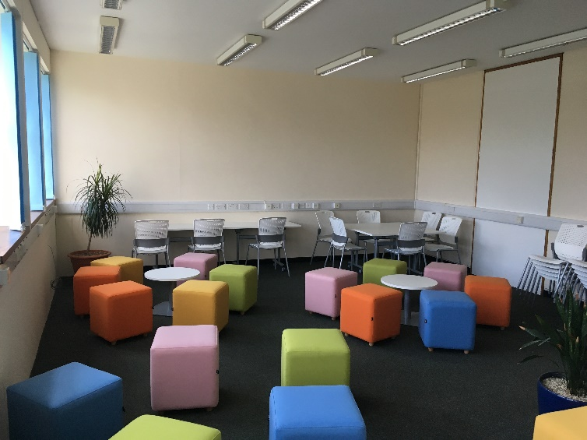
Sense of Community
Common Spaces
New Student Hub & Resource Centre
Activities
In conjunction with PsychoSoc, we will be running a variety of staff/student events
Pub Quiz
Sports Event
Creativity for Wellbeing Workshops
Drop-in sessions
Etc..

Slide 41
Sense of Community
Social Media
Follow us for all the latest news, research and events in Psychology:
Facebook: https://www.facebook.com/PsychologyUniversityOfSouthampton/
Twitter: @SotonPsych

Slide 42
Rest of the week

Slide 43
Effective Learning at University
Four identical sessions in 44/3029-3033
Tuesday 25th September
Red Group: 10.00 – 12.00
Blue Group: 12.30 – 14.30
Green Group: 15.00 – 17.00
Wednesday 26th September
Yellow Group: 09.30 – 11.30
You only need to attend ONE session!

Slide 44
Cognitive Mapping
Campus Orientation group activity
Identify key locations in Psychology and the University
Get to know the other members of your tutor group!
Preparation for PSYC1005 group work
Information sheet in your Induction Pack
Prizes for most creative, informative, and best overall maps
Maps to be displayed around Gallery in Building 44
Materials and submit: Student Office (44/2003)
Deadline: 15.00 on Monday 1st October (i.e., next Monday!).

Slide 45
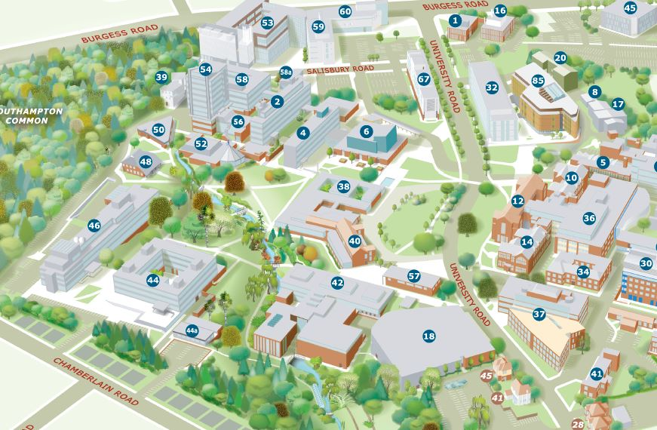
Lunch at Garden Court (Building 40)
Today: 13.00 – 13.45

Slide 46
For Further Information….
www.efolio.soton.ac.uk
https://blackboard.soton.ac.uk/webapps/login
www.efolio.soton.ac.uk/blog/handbook-jw-undergraduate-handbook--bsc-psychology

Slide 47
Work hard and enjoy Year 1!

